Slide 1
Lecture 2 Pre-Mendelian ideas about heredity – Vapour and fluid
theory, Magnetic power theory, Preformation theory, Lamarck’s theory, Darwin’s theory, Germplasm theory and Mutation theory

Slide 2
EARLIER CONCEPTS OF HEREDITY
Earlier concepts of heredity made their beginning first with the discovery of sexuality in organisms, both plants and animals.
The invention of the microscope gave a great impetus to probe into the world of microorganism and get a visual knowledge about the link between one generation and the other bringing about heredity transmission of characters.

Slide 3
EARLIER CONCEPTS OF HEREDITY
Reproductive organs in plants were reported for the first time by Grew in 1682.
Camerarius first time described sexual reproduction in plants.
In 1717 Thomas Fairchild produced a hybrid having characters of both the parents. The hybrid was called 'Fairchild's mule' - first artificial hybrid

Slide 4
History of Genetics
Early concept:
Among the biological sciences the science of genetics orginated 1900 with the rediscovery of Mendelian Principles.
Though pre-historic plants and animal breeders employed hybridisations and selection they were not aware of principles of genetics.
Early works forwarded various speculation and theories explain the phenomenon of heredity.
The ideas of early workers can be grouped into the following headings.

Slide 5
PRE- MENDELIAN CONCEPTS OF HEREDITY
Vapour and fluid theory
Magnetic power theory
Preformation theory
Theory of epigenesis
Particulate theory
Inheritance of acquired characters (Lamark’s theory)
Theory of natural selection (Darwin’s theory)
Theory of pangenesis
Germplasm theory

Slide 6
1. Vapour and fluid theory
Early Greek philosophers speculated that the hereditary information's
of parents existed in the form of vapours of fluids.
Pythagoras (500 B.C.) speculated that a moist “vapour” descended from the brain, nerves and other body organs of the male, an embryo was formed in the uterus of the female.
According to him, the male transmitted all the characters of the embryo and the female does not.
However, another Greek philosopher of the same age, Empedocles thought that both parents contributed equally to the embryo and each parent produces a “semen”’ which arises directly from various body parts.
After 200 years, another Greek philosopher Aristotle forwarded a highly imaginative speculation that the semen of the male had certain vitalizing or “dynamic” effect and it was supposed to be highly purified blood.
According to him, the female furnished the inert building materials, while the male gives the motion and new life to the material.

Slide 7
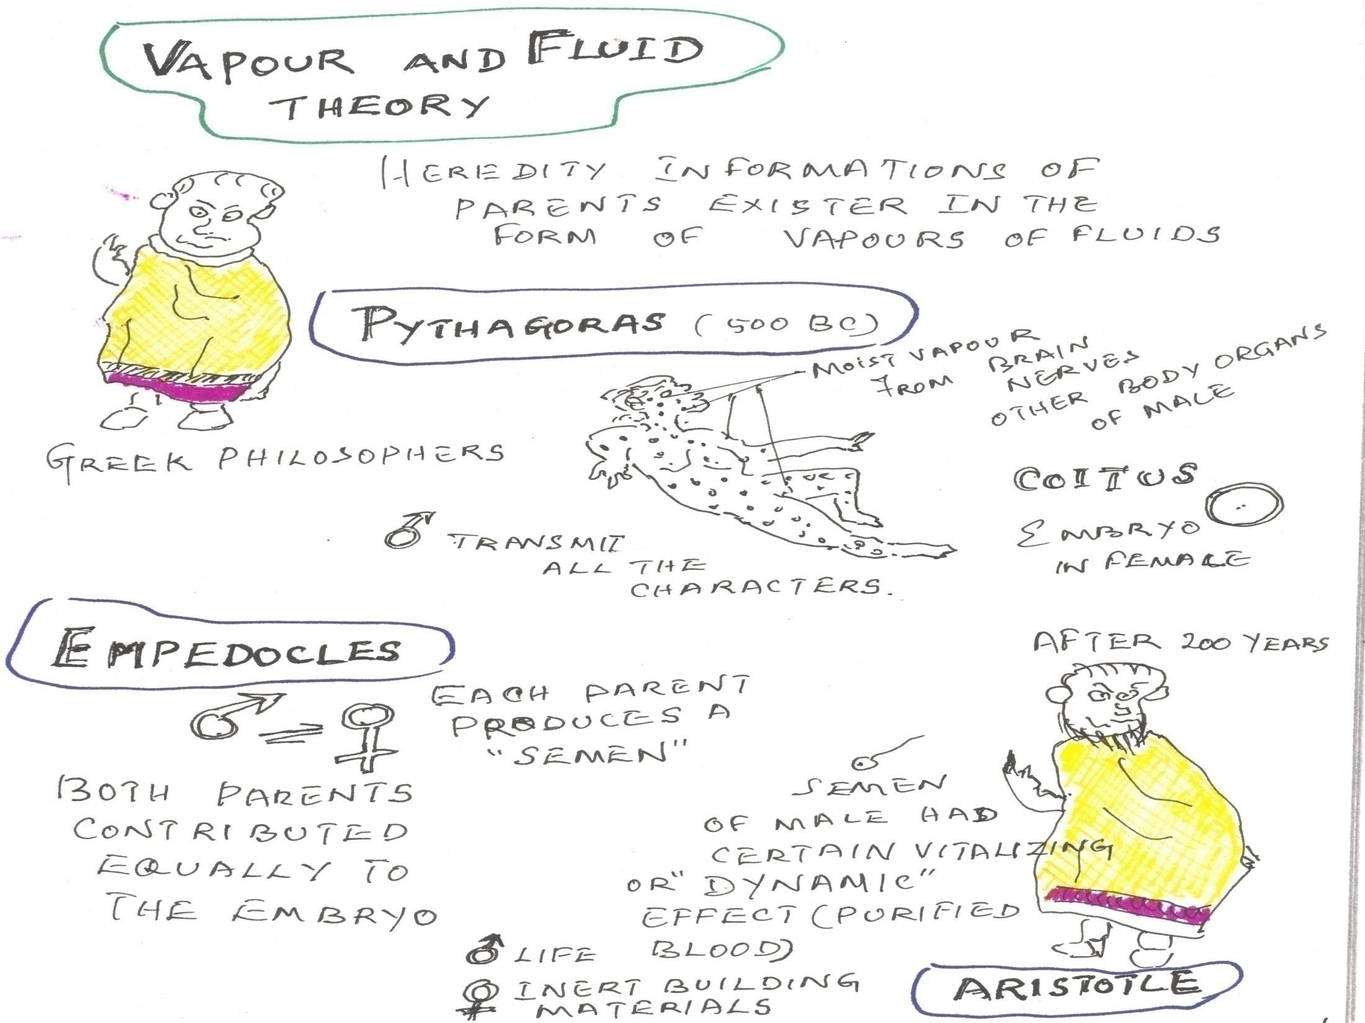
Heredity information’s of parents exists in the form of vapours of fluids
Moist vapour from Brain, Nerves and other body organs of male
Greek Philosophers
Transmit all
characters
Embryo in female
After 200 Years
Each parent produces a semen
Both parents contributed equally to the embryo
Semen of male had certain Vitalizing or Dynamic effect (purified blood)

Slide 8
2. Magnetic power theory
In the 17th century W.Harvey (1578-1657), after performing certain experiments on deer proposed the theory called magnetic power theory.
He proposed the uterus had some magnetic power to consume an embryo
He suggested that as iron by friction with a magnet possesses the magnetic properties, so that the uterus by the friction of male organ acquires some magnetic power to conceive an embryo.

Slide 9
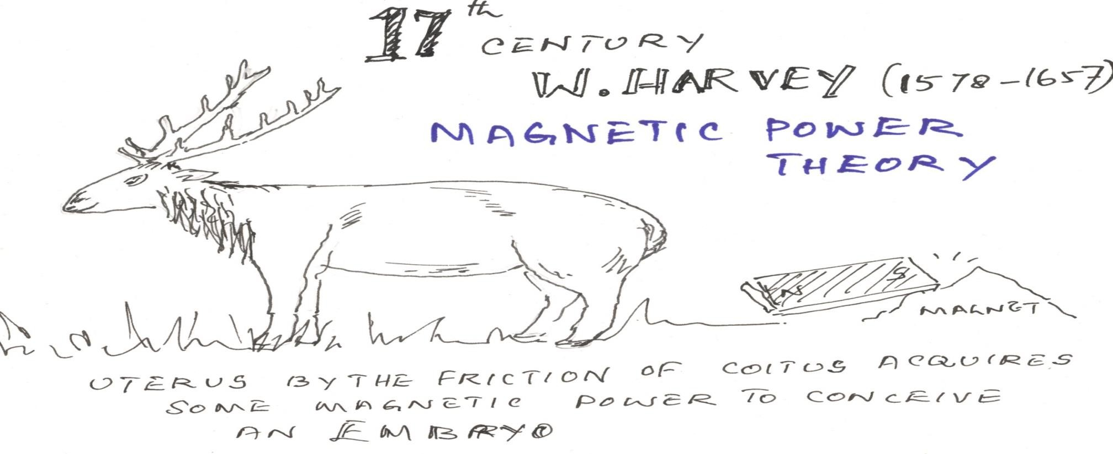
Uterus by the friction of coitus acquires some magnetic power to conceive an embryo
He proposed the uterus had some magnetic power to consume an embryo.

Slide 10
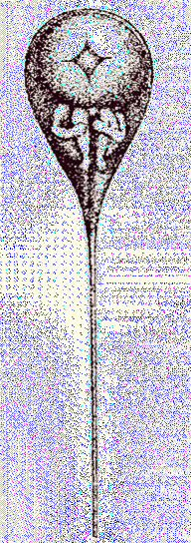
Swammerdam, an ovist, believed that the animal hemisphere
of the frog’s egg contained a tiny frog
Preformation Theory
Dutch Biologist Swammerdam and Bonnet (1720 -1793)
Miniature human called humanculus was already present (preformed ) in the egg and sperm. Development of zygote resulted only in the growth of miniature human who was already present in the egg and sperm.
not proved scientifically.

Slide 11
4.Theory of Epigenesis
Wolf (1738 – 1794) who opposed the Preformation concept, opined that, neither the egg nor the sperm had
a preformed organism, but both of them undifferentiated mass of living substance
have which
developed into the organisms after fertilization.
According to this theory called epigenesis new organs and tissues are formed denovo (from the mass of living substances in the gametes) due to vital forces.

Slide 12
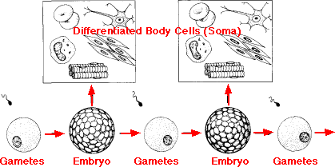
4. Theory of Epigenesis
Advocated by Wolf (1738 – 1794) German Biologist
Egg or sperm are undifferentiated – differentiation takes place only after fertilization from the zygote resulting into development of adult tissues and organs
Concept of epigenesis – universally accepted

Slide 13
5. Particulate theory
Particulate Theory - Maupertius (1698 - 1759)
Maupertius proposed that both the parents produce the gametes.
Egg and sperm united to produce embryo.
Each organ of embryo is made of two parts of embryo one is come from male, another one female.

Slide 14
6. Theory Of Acquired Characters
Proposed by Lamarck (1744-1829), a French biologist.
A new character once acquired by individual shall pass on to its progeny.
It means that environmental changes cause modifications in organisms and such modifications are transmitted to subsequent generations.
Such bodily changes are called acquired characters
If a man develops a strong muscle by exercise all his children will have strong muscle. On the other hand, if a person becomes weak all his children will be weak.
This theory was disproved by Weismann when he cut the tail of mice for 22 successive generations and always got the baby mice with tail and the theory was soon given up.

Slide 15
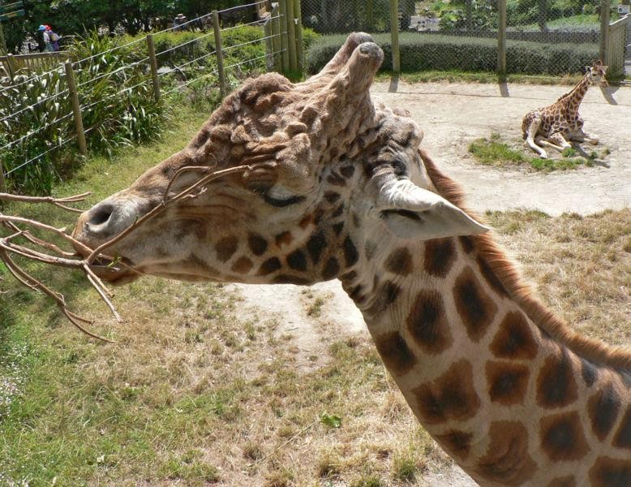
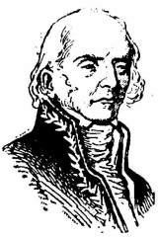
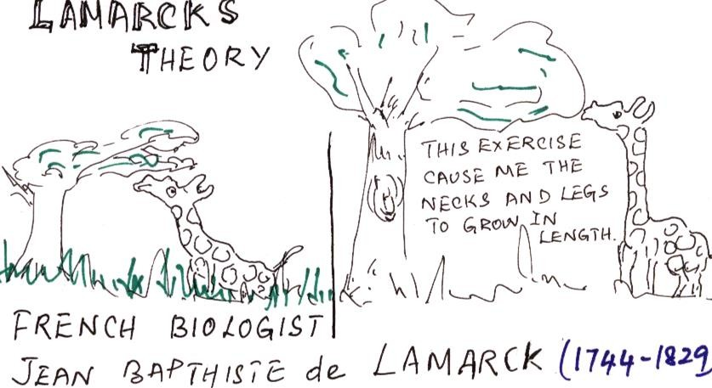
Jean Baptist
Environmental changes causes modification in organisms Such modifications are transmitted to subsequent generation

Slide 16
Example for theory of acquired inheritance
Giraffie live in the interior part of the Africa. So it feed on the leaves of tall tree and to strain itself continuously to reach them.
Such exercise caused the legs and necks to grow in length.
The increased length was inherited by the progeny touched the legs and neck and over generation it will continue.
This has evolved the present day 6 metre giraffie.

Slide 17
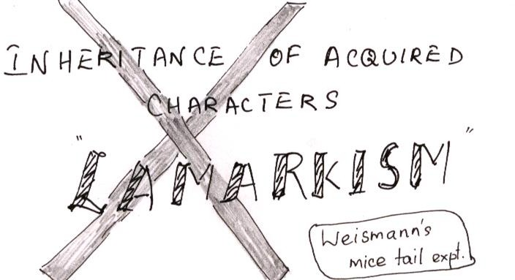
This was negated by Weismann (1834 –
1914) by his expts. on rats

Slide 18
7. PANGENESIS THEORY
Hippocrates (400 BC) believed that reproductive material is produced from all parts of the body so that all the characters are represented in the progeny.
Charles Darwin (1809-1882) theory of Pangenesis According to this all parts of the body produce invisible gemmules or pangenes which are carried into sex organs via blood stream. There the pangenes are assembled into gametes.
During fertilization, pangenes of mother and father combine to produce the character of the offspring.

Slide 19
8. Theory of Natural Selection
Proposed by Charles Darwin (1809 – 1882)
According to this theory, many more individuals of each species are born than can possibly survive and consequently there is always a struggle for existence.
If hereditary differences occur within the wild species of plants, nature will eliminate some and select others.
Over-production, struggle for existence, hereditary variations and survival of the fittest are thus the important principle of the theory of natural selection.
Published Origin of Species (1859) and proposed the 'Hypothesis of Pangenesis' (1868)

Slide 20
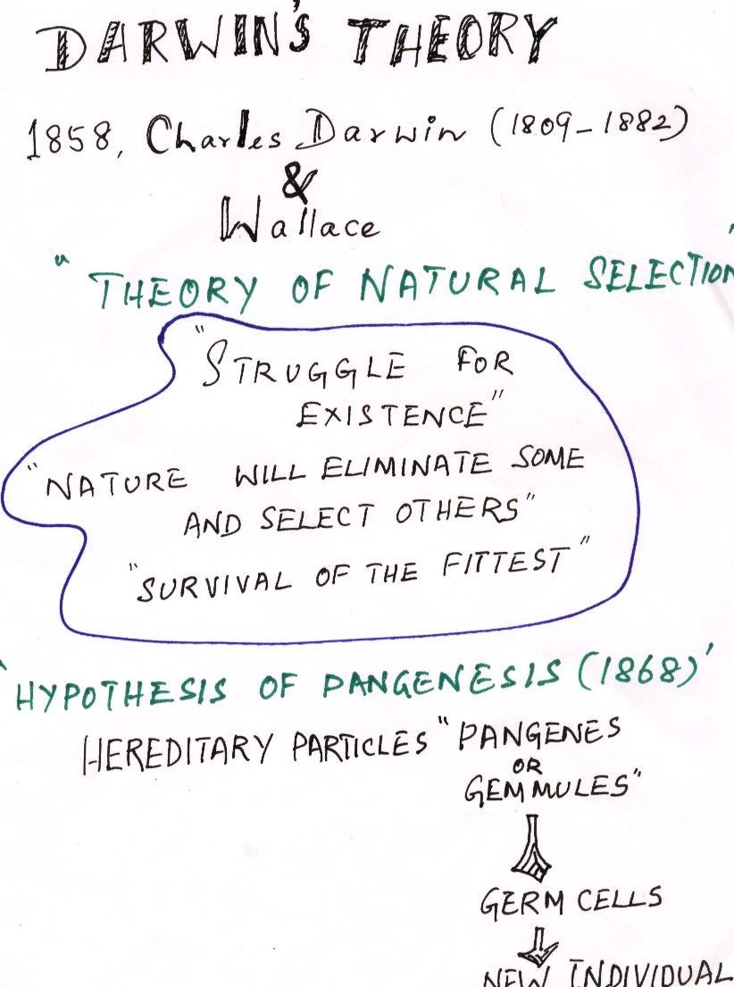
Hypothesis of Pangenes (1868)
Very small exact but invisible -Heriditary particles “Pangenes or Gemmules”
- transported by the blood stream to sex organs
Assembled in gametes or Germ Cells- After fertilization- New Individual

Slide 21
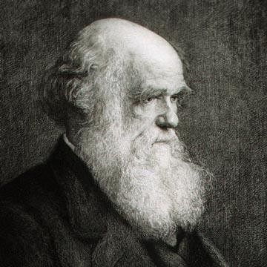
Natural selection
Charles Darwin, (1809 - 1882) who rocked the world with his theory of natural selection.
How does a species evolve? Occasionally, changes (DNA mutations) will occur in a gene as it passes from one generation to the next. Some of them affect an animal's appearance, behaviour or the way its body works. Sometimes, an animal with a new version of a gene survives better than an animal with the old version - 'the survival of the fittest': then that animal is likely to have more offspring. They will inherit the new version of the gene, and in turn pass it on to their young.

Slide 22
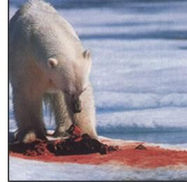
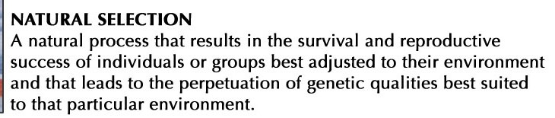

Slide 23
9. Germplasm Theory
Weismann (1834-1914), a German zoologist, suggested in 1889
According to 'Germplasm Theory of Heredity', the body tissues are of two types viz., germplasm and somatoplasm.
The germplasm refers to the reproductive tissues or cells that produces the gametes.
The somatoplasm includes all other body tissues which are not related to sexual reproduction.
Thus transmission of characters from one generation to other takes place through germplasm.
Any change in the germplasm will lead to change in the next generation.
This theory was accepted in broad sense.

Slide 24
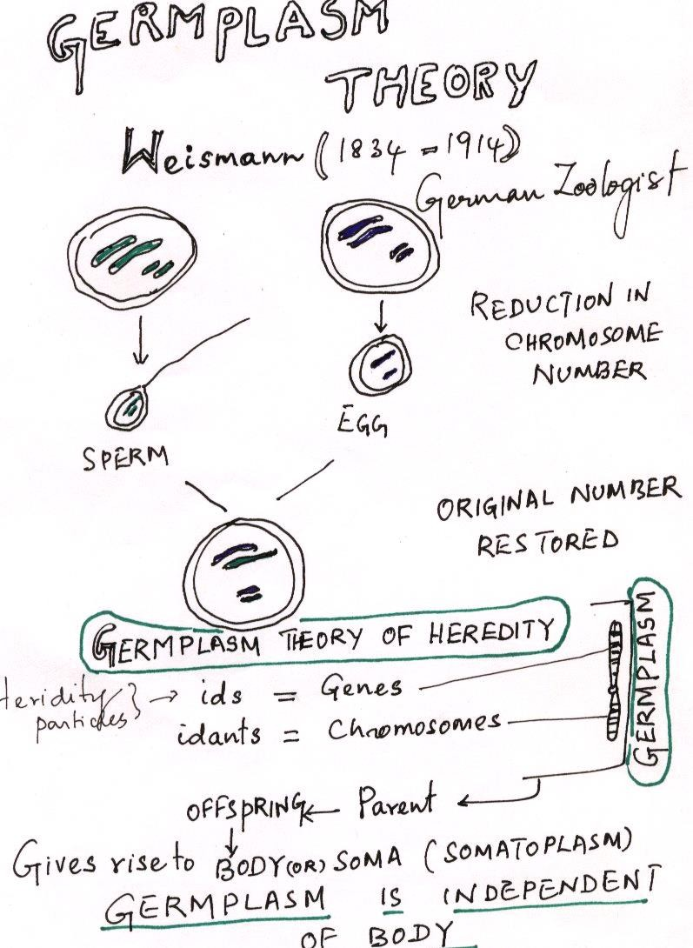

Slide 25
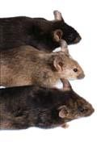
Weismann (1834 - 1914)
Cut off the tails of a group of experimental mice for 22 successive generations
Was the progenies tailless? NO
He proposed Germplam Theory
The Body of an individual
Somatoplasm
Do not contribute to sexual reproduction
Germplasm
Produce gametes- basis of sexual reproduction

Slide 26
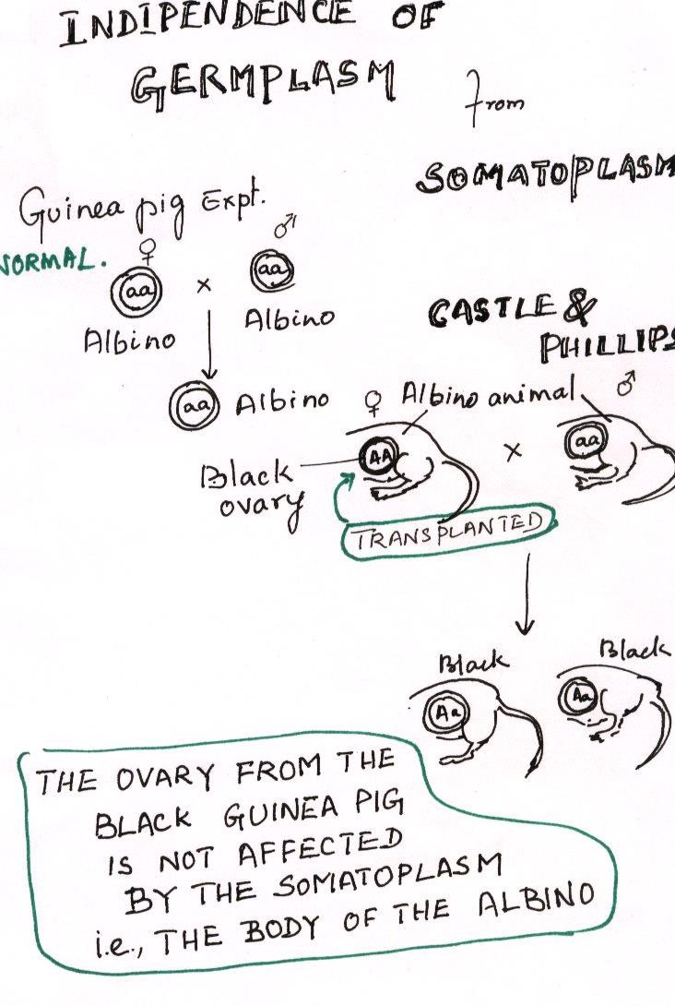
Castle and Phillips (1909)
Disposed off the hypothesis of pangenesis and inheritance of acquired characters

Slide 27
Large discontinues variation in the genotypes

Slide 28
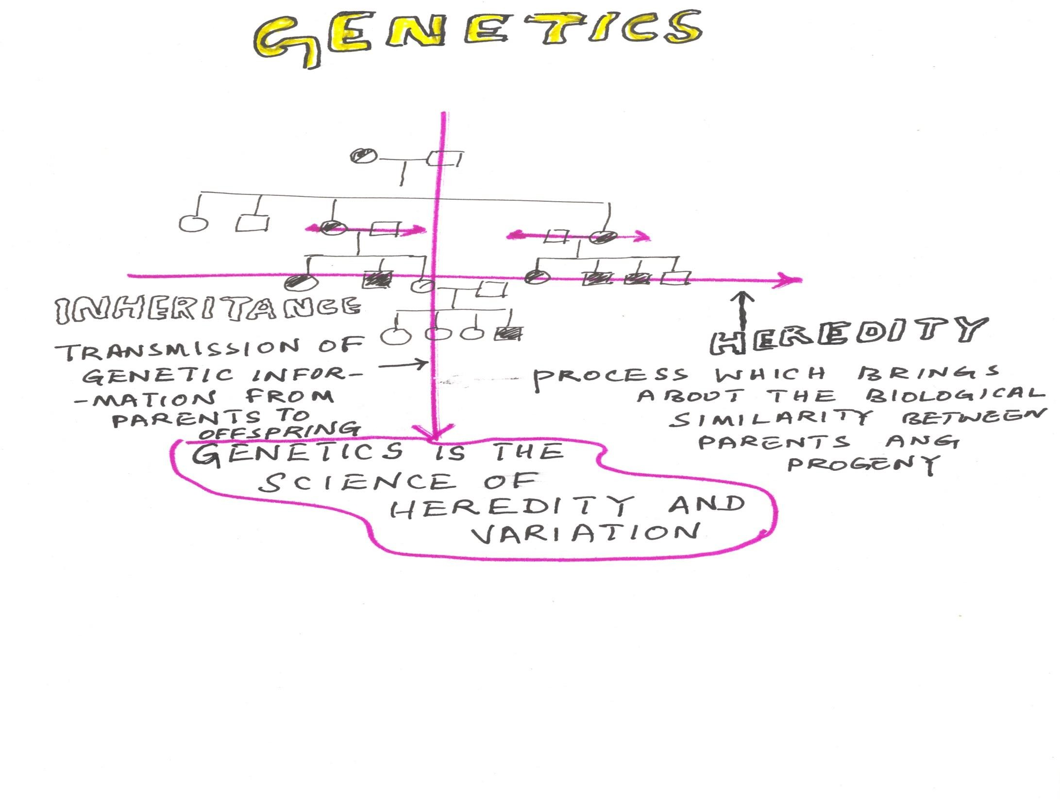
Genetics derived from Greek root-
gen = to become or
to grow into
The science that deals with the structure, organization, transmission and function of genes and the origin of variation in them

